Slide 1

PEMBELAJARAN MESIN
(IF216007)
oleh:
Wildan Budiawan Zulfikar, ST., M.Kom
Dian Sa’adillah Maylawati, S.Kom., MT
JURUSAN INFORMATIKA
FAKULTAS SAINS DAN TEKNOLOGI
UIN SUNAN GUNUNG DJATI BANDUNG
2022

Slide 2
Kontrak Perkuliahan
Aturan Perkuliahan:
Ontime
Camera On (Online)
Aturan Penilaian:
UAS 25%, UTS 25%
Sikap 25%, Assignment 25%
Syarat Kelulusan:
Nilai minimal C
Credit Point:
3 SKS (2+1)

Slide 3
Absensi dan VICON (C, D, E)
Jadwal Absensi di LMS = jadwal di SALAM
absen di LMS mulai jam 6.00-23.00
Jadwal Vicon bisa berbeda dari jadwal di SALAM

Slide 4
Capaian Perkuliahan
PLO-02: Mampu menyelesaikan permasalahan dengan formulasi solusi efisien berbasis prinsip - prinsip komputasi
CLO-1: Mahasiswa mampu menjelaskan konsep pembelajaran mesin dan mengidentifikasi kebutuhan data dalam konsep pembelajaran mesin
PLO-04: Memiliki pengetahuan dan pemahaman yang komprehensif pada area yang spesifik di bidang informatika
CLO-2: Mahasiswa mampu menjelaskan dan mengidentifikasi karakter dari algoritma supervised (klasifikasi dan regresi), unsupervised (klustering dan asosiasi), semi-supervised learning, dan reinforcement learning.
PLO-05: Mampu beradaptasi terhadap penggunaan metode baru pada konteks permasalahan yang dinamis
CLO-3: Mahasiswa mampu menjelaskan konsep Deep Learning dan mengidentifikasi algoritma Deep Learning dalam penyelesaian masalah klasifikasi atau klasterisasi.
PLO-06: Mampu berkolaborasi dengan berbagai disiplin ilmu lain yang relevan secara komprehensif

Slide 5
Keterkaitan Mata Kuliah
Semester 5
Semester 6
MK Pilihan
Intelegensia Buatan
Pembelajaran Mesin
Teknologi Big Data
Pemrosesan Bahasa Alami
Sistem Temu Kembali
Penggalian Data
Pengolahan Citra Digital
Pembelajaran Mesin Lanjut

Slide 6
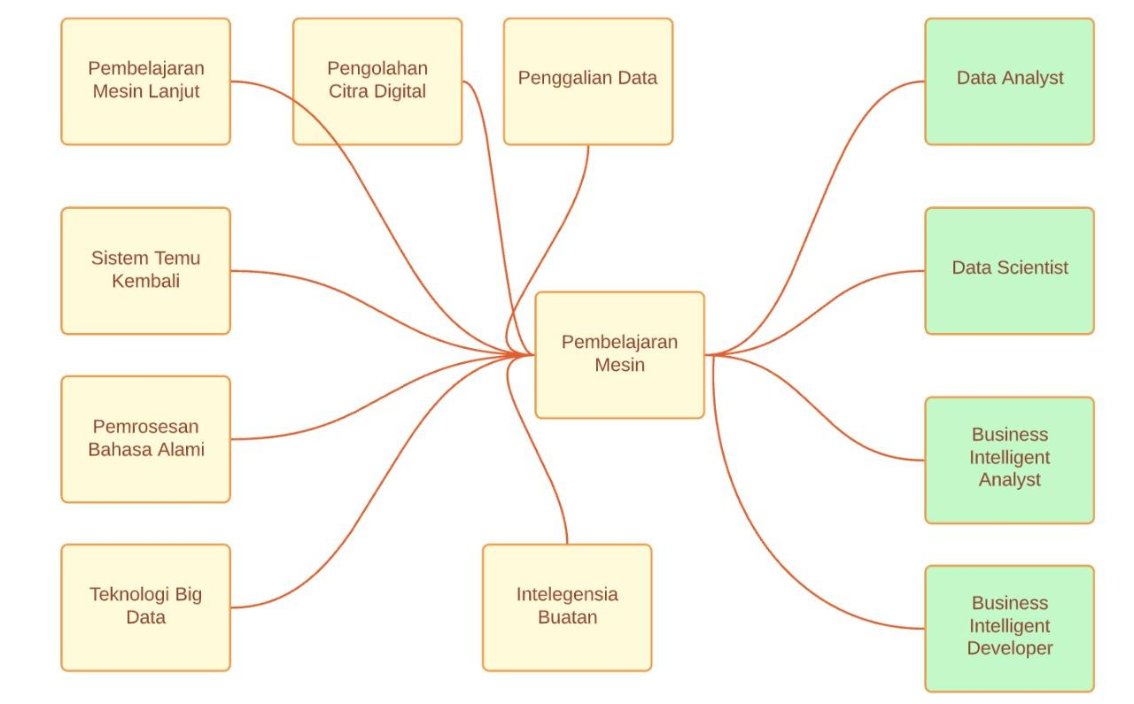
Keterkaitan Mata Kuliah

Slide 7
Materi Setiap Pertemuan
1. Pengenalan Machine Learning: Reinforcement Learning, Unsupervised Learning, Supervised Learning, Semi-supervised Learning
8. Unsupervised Learning: K-Means, K-Means++, dan Mini Batch K-Means
2. Mengenal, Menyiapkan, dan Memvisualisasikan Data (terstruktur dan tidak terstruktur)
9. Unsupervised Learning: Hierarchical Clustering (Agglomerative dan Divisive) dan DBCSAN
3. Regresi: Regresi Linier sederhana dan variabel jamak, Regresi Polinomial dan Non-linier
10. Association Rule, Frequent Pattern Growth, dan PrefixSpan
11. Deep Learning (Supervised): Convolutional Neural Network
4. Regresi: Support Vector Regression, Decision Tree Regression, Random Forest Regression
12. Deep Learning (Supervised): Recurrent Neural Network dan Long Short Term Memory
5. Reinforcement Learning dan Linear Theory
13. Deep Learning (Unsupervised): Deep Belief Network
6. Supervised Learning: Decision Tree, Random Forest, K-Nearest Neigbor, dan Naive Bayes
14. Semi-Supervised: Semi-supervised Clustering dan Semi-supervised Classification
7. Supervised Learning: Artificial Neural Network, dan Support Vector Machine

Slide 8
Referensi
1. RAHARJO, Budi. PEMBELAJARAN MESIN (Machine Learning). Penerbit Yayasan Prima Agus Teknik, 2021, 1-110.
2. AURÉLIEN, Géron. Hands-on machine learning with scikit-learn & tensorflow. Geron Aurelien, 2017.
3. MÜLLER, Andreas C.; GUIDO, Sarah. Introduction to machine learning with Python: a guide for data scientists. " O'Reilly Media, Inc.", 2016.
4. RUSSELL, Rudolph. Machine Learning: Step-By-Step Guide to Implement Machine Learning Algorithms with Python. 2018.
5. SUTTON, Richard S.; BARTO, Andrew G. Reinforcement learning: An introduction. MIT press, 2018.
6. HAN, Jiawei; PEI, Jian; KAMBER, Micheline. Data mining: concepts and techniques. Elsevier, 2011.

Slide 9
(IF216007)
Pengenalan Machine Learning: Reinforcement Learning, Unsupervised Learning, Supervised Learning, Semi-supervised Learning
oleh:
Wildan Budiawan Zulfikar, ST., M.Kom
Dian Sa’adillah Maylawati, S.Kom., MT
JURUSAN INFORMATIKA
FAKULTAS SAINS DAN TEKNOLOGI
UIN SUNAN GUNUNG DJATI BANDUNG
2022

Slide 10
Indikator Ketercapaian
Outcome Mata Kuliah
Outcome Program Studi
CLO-1: Mahasiswa mampu menjelaskan konsep pembelajaran mesin dan mengidentifikasi kebutuhan data dalam konsep pembelajaran mesin
PLO-02: Mampu menyelesaikan permasalahan dengan formulasi solusi efisien berbasis prinsip - prinsip komputasi
PLO-04: Memiliki pengetahuan dan pemahaman yang komprehensif pada area yang spesifik di bidang informatika
Outcome Perkuliahan
Mahasiswa mampu menjelaskan konsep pembelajaran mesin dan berbagai pemanfaatannya.

Slide 11
Apa itu Machine Learning?
Machine learning is a method of data analysis that automates analytical model building. It is a branch of artificial intelligence based on the idea that systems can learn from data, identify patterns and make decisions with minimal human intervention - SAS Insight
Machine learning is a branch of artificial intelligence (AI) and computer science which focuses on the use of data and algorithms to imitate the way that humans learn, gradually improving its accuracy - IBM
Machine learning is an application of artificial intelligence (AI) that provides systems the ability to automatically learn and improve from experience without being explicitly programmed. Machine learning focuses on the development of computer programs that can access data and use it to learn for themselves – expert.ai

Slide 12
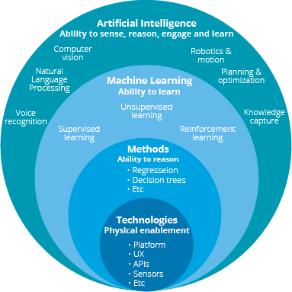
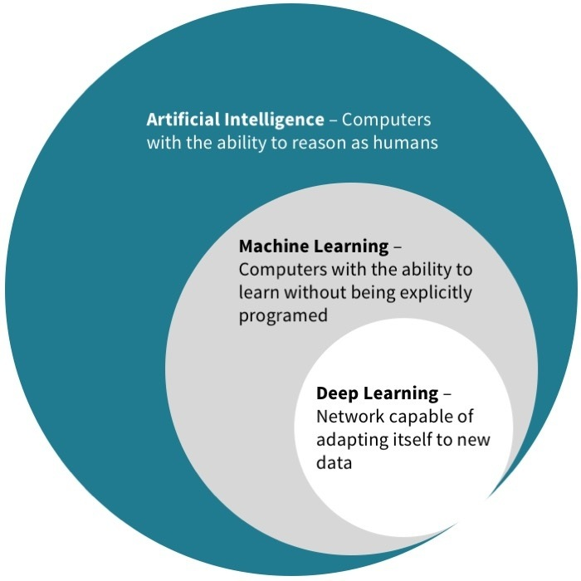
Posisi Machine Learning

Slide 13
Machine Learning Methods
The use of labeled datasets to train algorithms that accurately classify data or predict outcomes is known as supervised machine learning.
As more data is introduced into the model, the weights are adjusted until the model is properly fitted.
Supervised Learning
Unsupervised Learning
Unsupervised machine learning, also known as unlabeled machine learning, analyzes and clusters unlabeled datasets using machine learning techniques.
Without the need for human intervention, these algorithms uncover hidden patterns or data groupings.
Reinforcement Learning
Semi-Supervised Learning
Reinforcement machine learning is a behavioral machine learning paradigm that is comparable to supervised learning but does not use sample data to train the algorithm.
Using trial and error, this model learns as it goes. To establish the optimal advice or policy for a given situation, a series of successful outcomes will be reinforced.
Between supervised and unsupervised learning, semi-supervised learning is a good compromise.
It guides categorization and feature extraction from a larger, unlabeled data set using a smaller labeled data set during training.
https://www.ibm.com/cloud/learn/machine-learning

Slide 14




Machine Learning Methods and Its Functions
Classification
Image Classification
Identity Fraud Detection
Diagnostics
Customer retention
Object Detection
Opinion Mining
Sentiment Analysis
Regression
Advertising Popularity
Weather Forecasting
Market Forecasting
Estimating life expectancy
Population growth prediction
Association
Pattern recognition/ analysis
Market analysis
Recommender system
Targeted Marketing
Clustering
Document clustering
Social Media Analysis
Topic Modeling
Customer Segmentation
Real-Time decisions
Robot Navigation
Learning Tasks
Skill Acquisition
Game AI
Semi-supervised classification
Semi-supervised clustering
Supervised Learning
Unsupervised Learning
Reinforcement Learning
Semi-supervised Learning

Slide 15
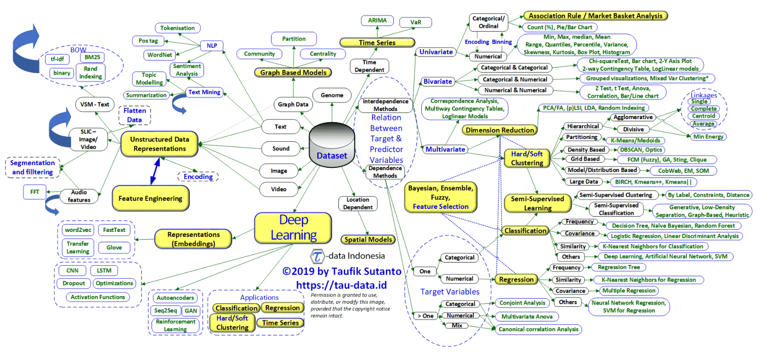
Big Picture of AI Data and Methods

Slide 16
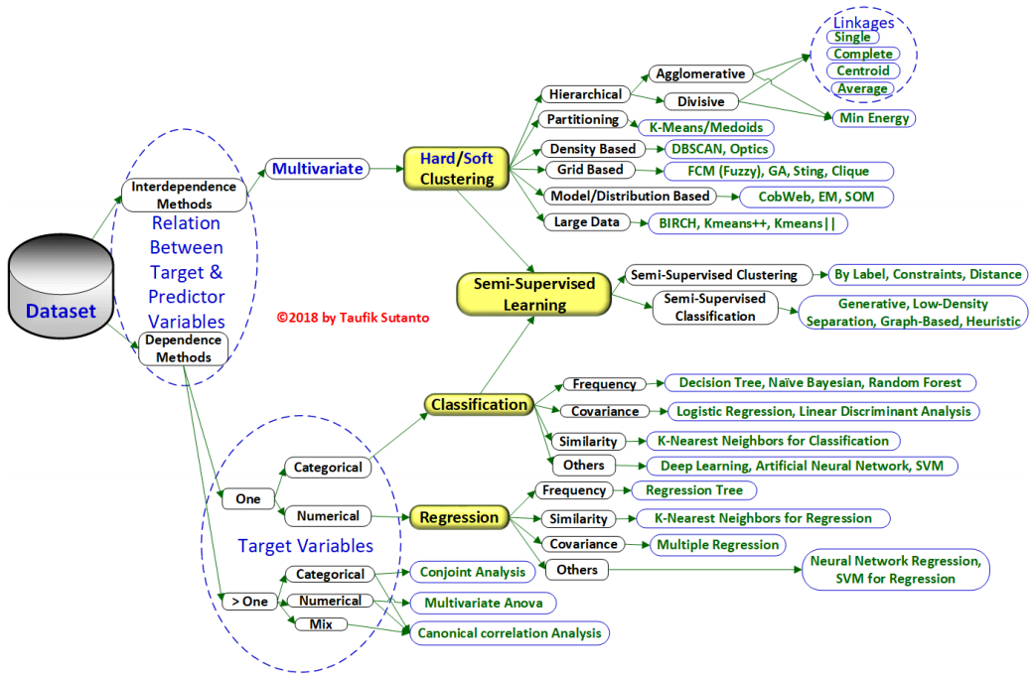

Contoh Algoritma/ Metode Pembelajaran Mesin
https://tau-data.id/psd-03/

Slide 17
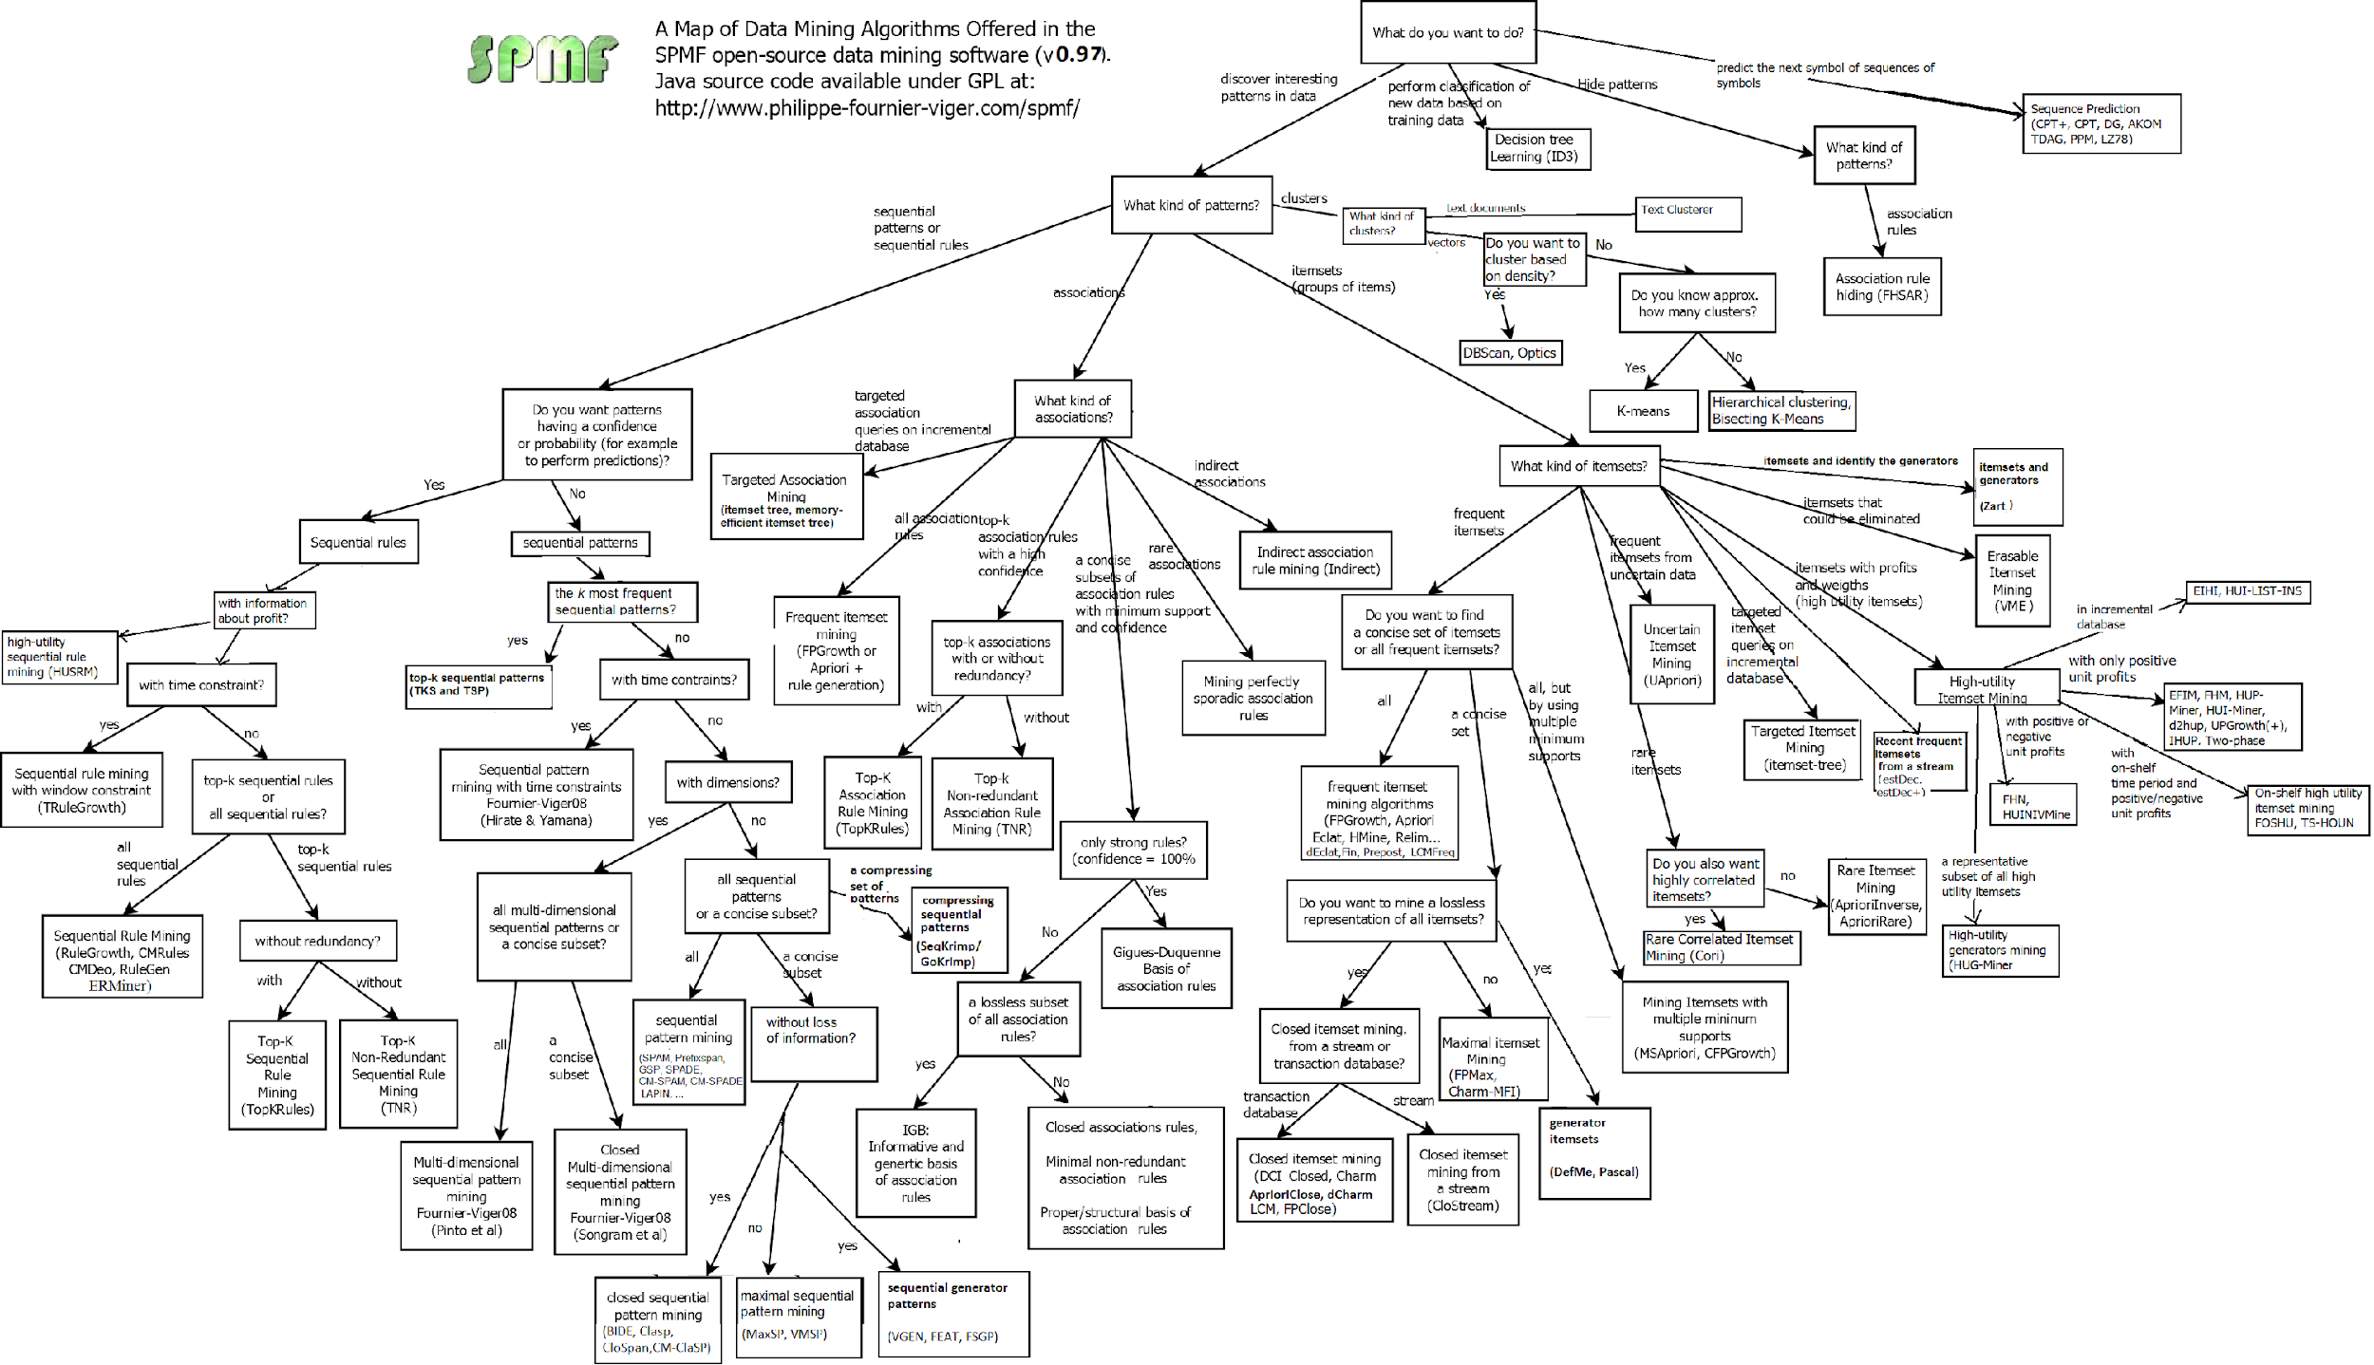
Contoh Algoritma/ Metode Pembelajaran Mesin (Association)

Slide 18
Quiz!!!
Jelaskan pemahaman Anda tentang pembelajaran mesin!
Jelaskan pemahaman Anda tentang perbedaan supervised, unsupervised, semi-supervised, dan reinforcement learning!
Berikan contoh studi kasus yang dapat diselesaikan dengan pembelajaran mesin, lalu metode pembelajaran mesin apa yang bisa Anda gunakan? Mengapa menggunakan metode tersebut?

Slide 19














Praktikum

Slide 20
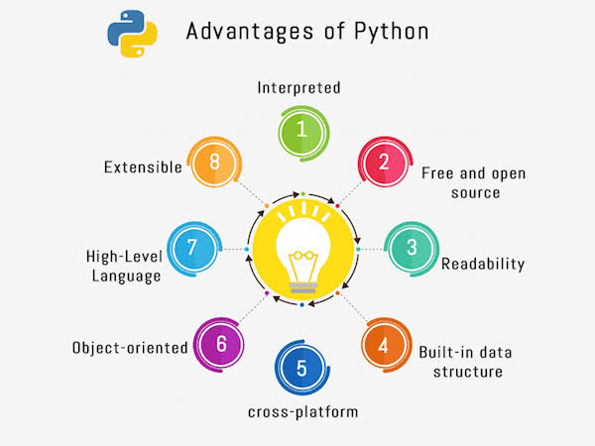
Why Python?
https://twitter.com/pythonpro22/status/1465576908150636550

Slide 21
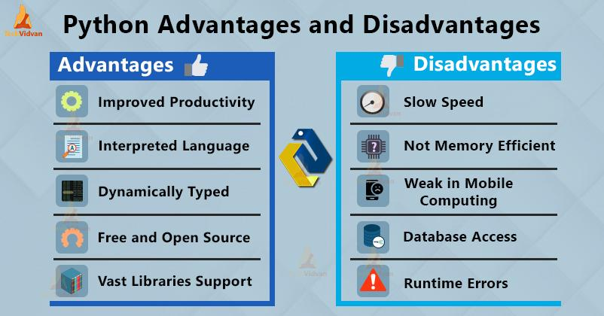
Pro-Cons
https://techvidvan.com/tutorials/python-advantages-and-disadvantages/

Slide 22
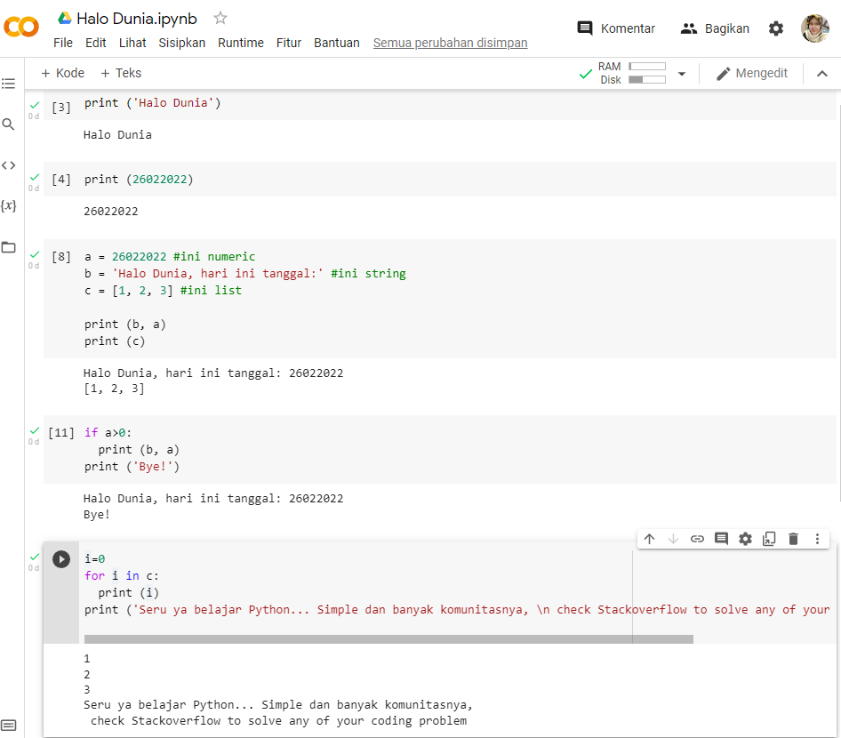

Google Colab
https://colab.research.google.com/

Slide 23
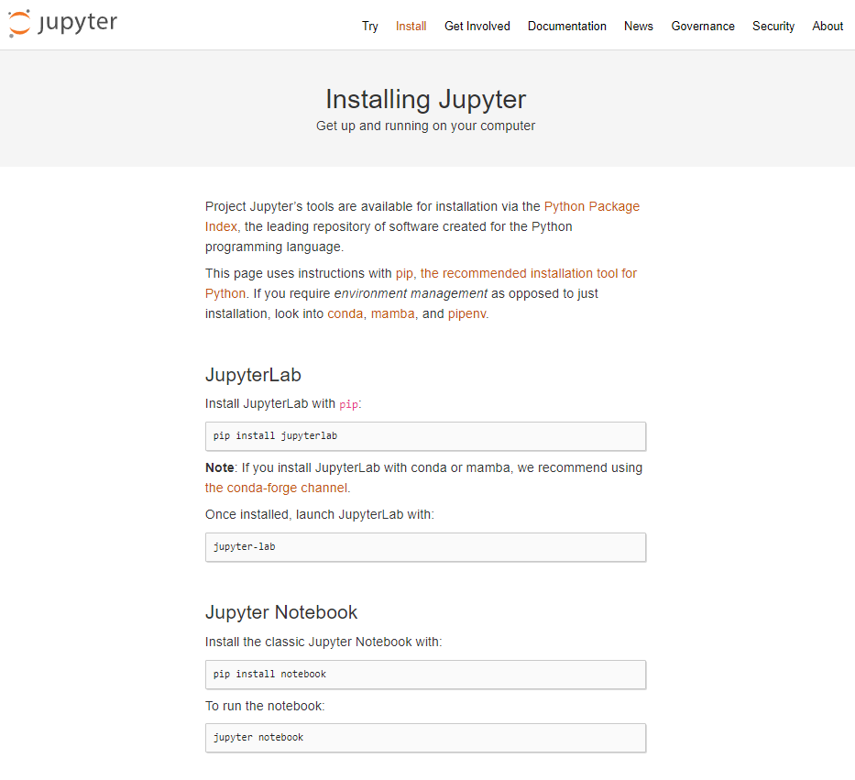
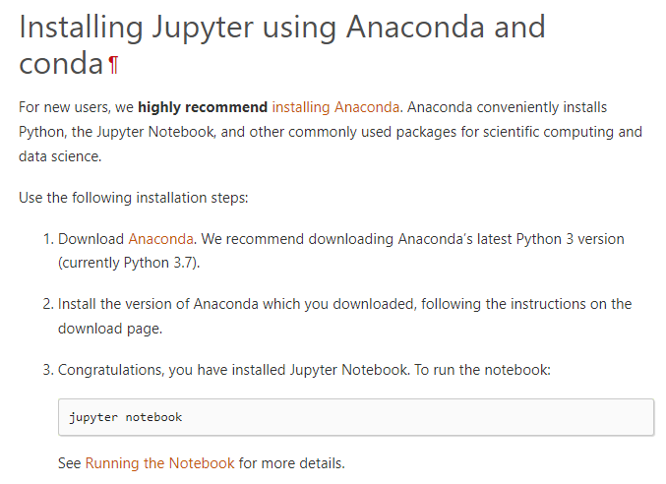
Instalasi Jupyter Notebook
https://jupyter.org/install
https://docs.jupyter.org/en/latest/install/notebook-classic.html
https://www.anaconda.com/products/individual
https://docs.jupyter.org/en/latest/running.html#running

Slide 24
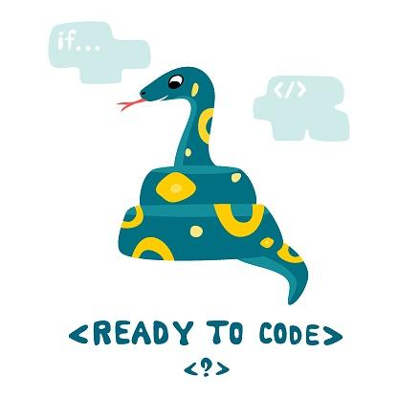
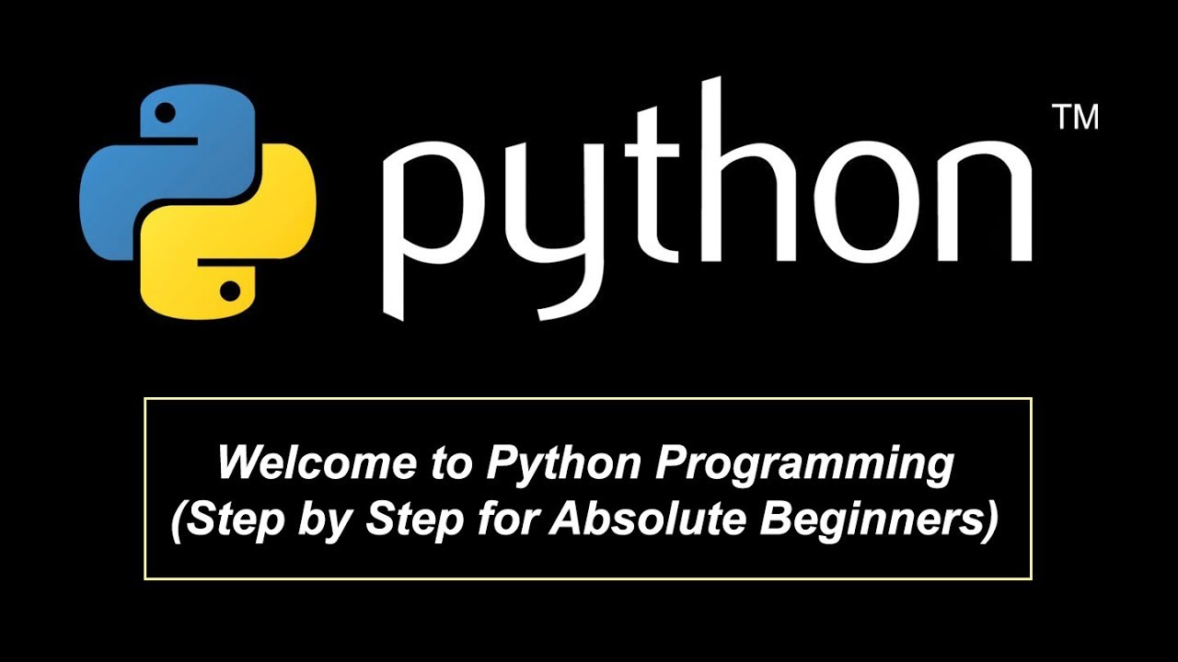
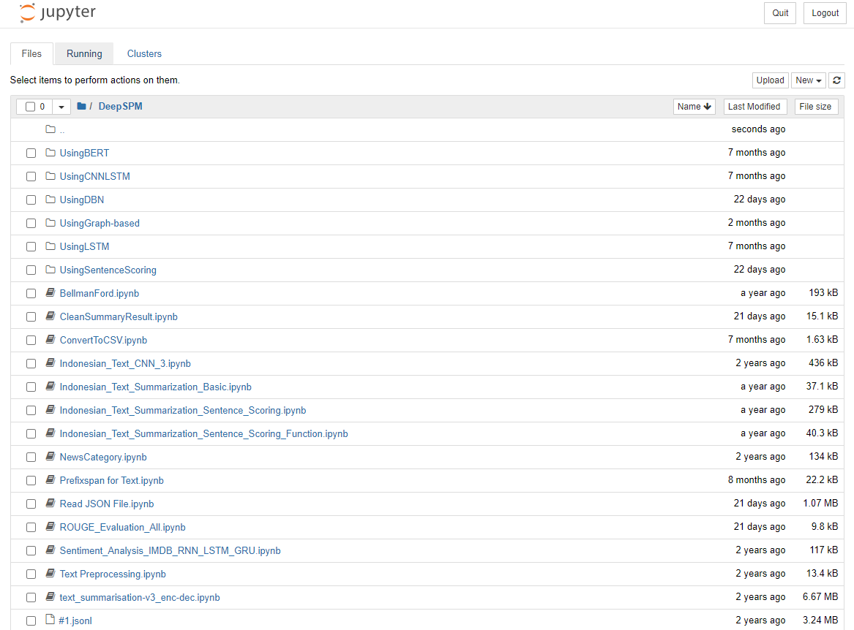
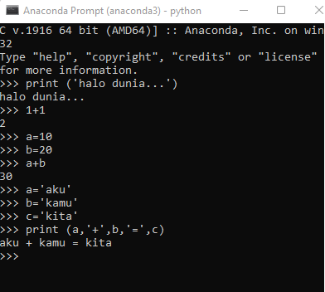
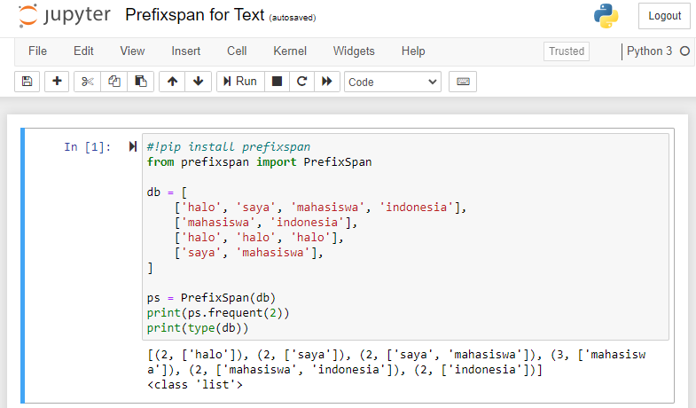
Instalasi Jupyter Notebook

Slide 25
Library Installation
Buka Anaconda Command Prompt
pip install nama_libary
pip install nama_library==versi_library
Melalui Jupyter Notebook
!pip install nama_library
!pip install nama_library==versi_library
Note: sering kali, berbeda versi mempengaruhi fungsi-fungsi di kode program kita, kadang perlu ada kecocokan pula antara versi library dengan versi Python kita supaya fungsi berjalan baik.

Slide 26
Alternatif Install Jupyter Notebook dan libs via Docker
https://github.com/WildanBudiawanZ/jupyter-notebook

Slide 27

Tugas Praktikum!
Silahkan install Jupyter Notebook
Install library berikut: NumPy, SciPy, Pandas, Matplotlib, Seaborn, Scikit-learn, Keras, Tensorflow

Slide 28
Referensi
1. RAHARJO, Budi. PEMBELAJARAN MESIN (Machine Learning). Penerbit Yayasan Prima Agus Teknik, 2021, 1-110.
2. AURÉLIEN, Géron. Hands-on machine learning with scikit-learn & tensorflow. Geron Aurelien, 2017.
3. MÜLLER, Andreas C.; GUIDO, Sarah. Introduction to machine learning with Python: a guide for data scientists. " O'Reilly Media, Inc.", 2016.
4. RUSSELL, Rudolph. Machine Learning: Step-By-Step Guide to Implement Machine Learning Algorithms with Python. 2018.
5. SUTTON, Richard S.; BARTO, Andrew G. Reinforcement learning: An introduction. MIT press, 2018.
6. HAN, Jiawei; PEI, Jian; KAMBER, Micheline. Data mining: concepts and techniques. Elsevier, 2011.
7. Python for Data Science: https://cognitiveclass.ai/courses/python-for-data-science
8. Introduction to Python for Data Science: https://www.datacamp.com/courses/intro-to-python-for-data-science
9. Build real-world applications with Python: https://docs.microsoft.com/en-us/learn/paths/python-language/
10. Introduction to Python for Data Science: https://learning.edx.org/course/course-v1:Microsoft+DAT208x+3T2018/home
11. Data Visualization with Python: https://cognitiveclass.ai/courses/data-visualization-with-python

